Slide 1
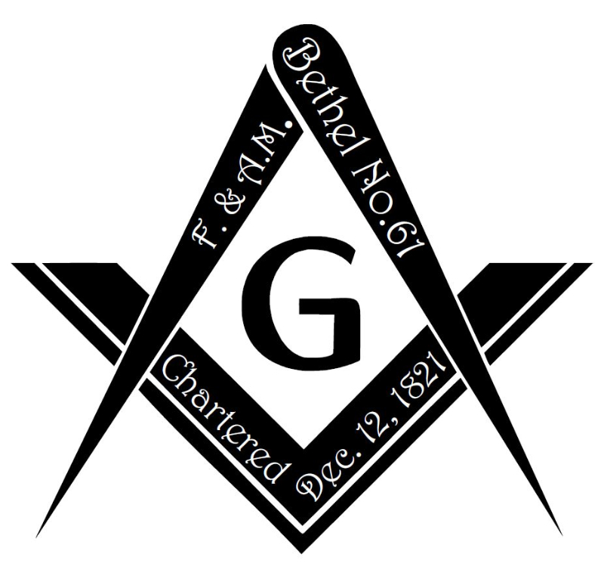
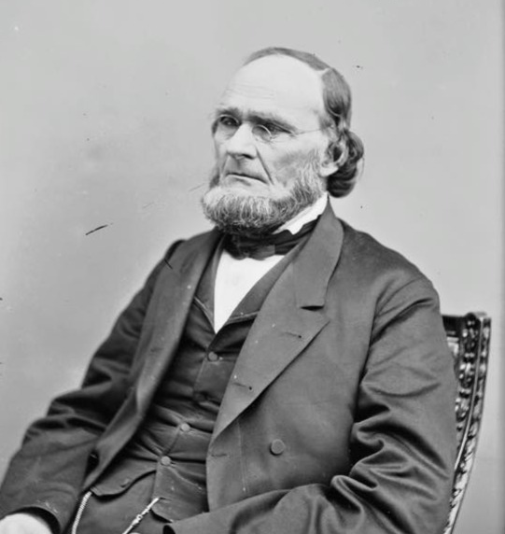
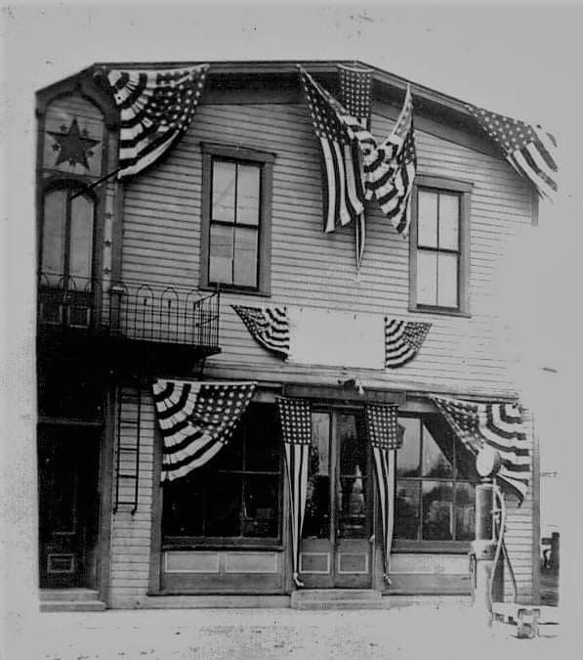
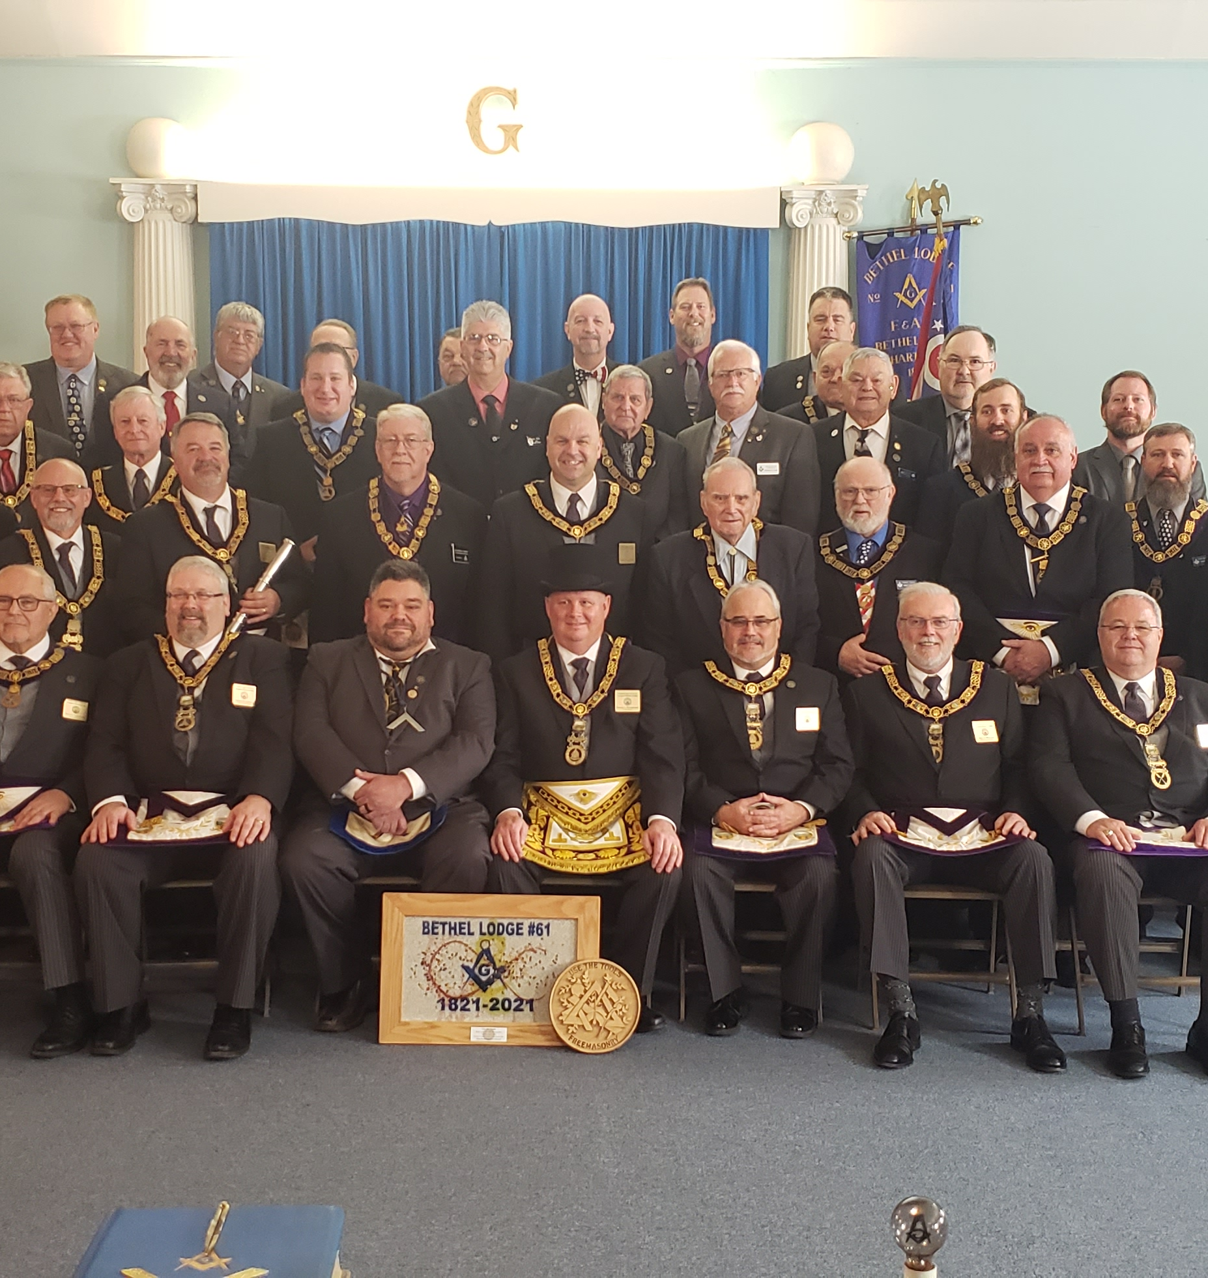
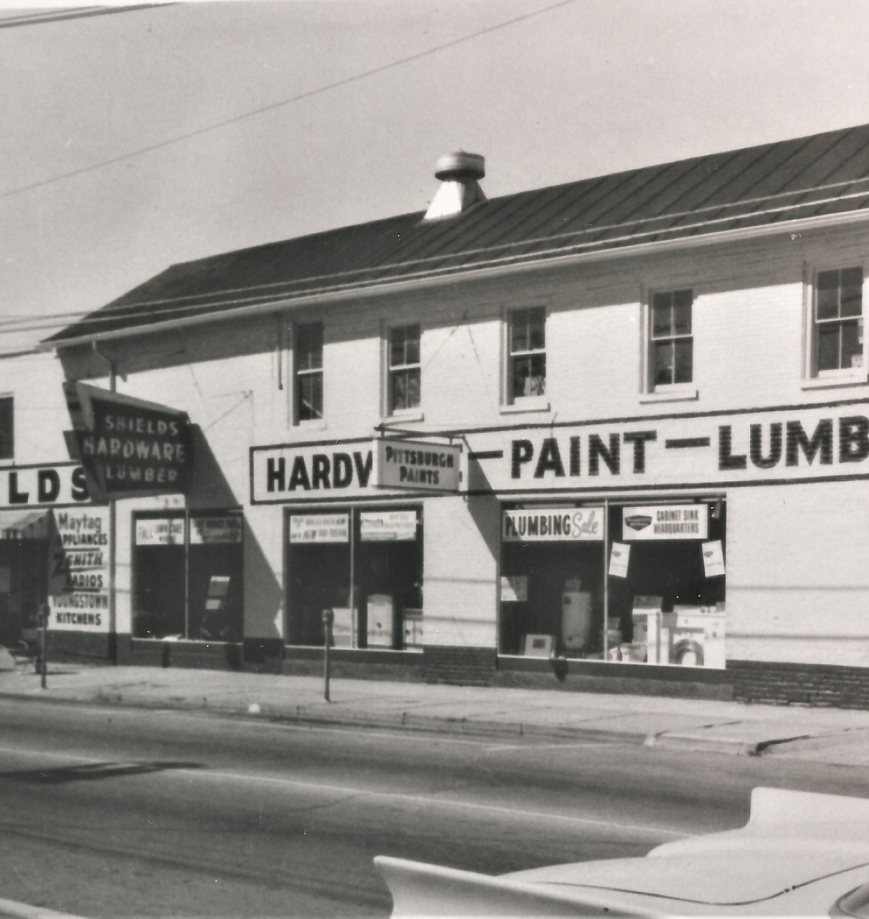
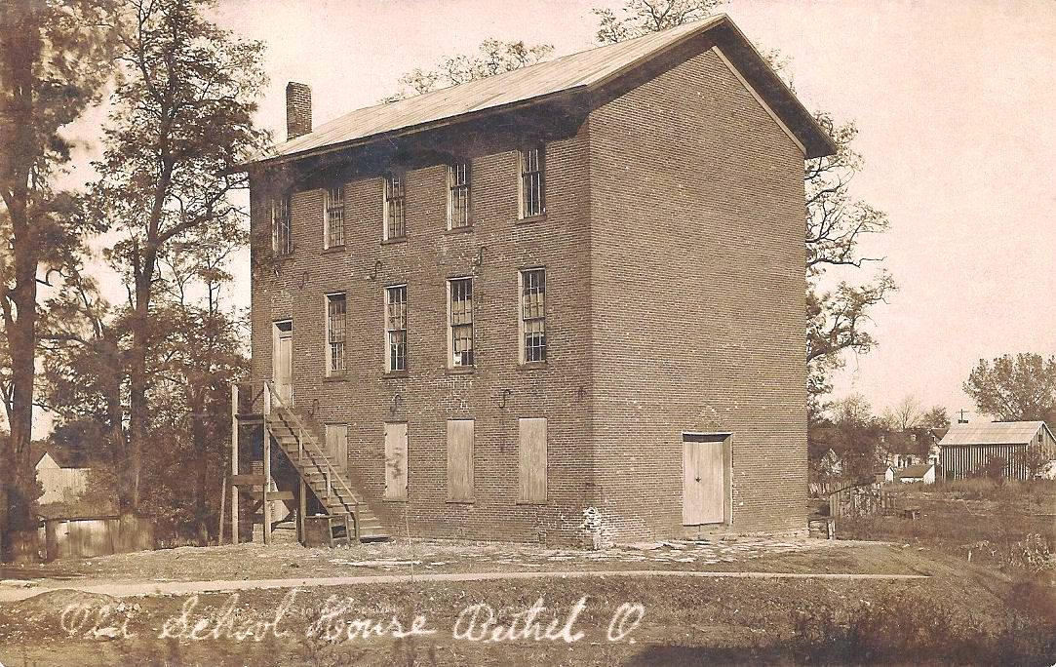
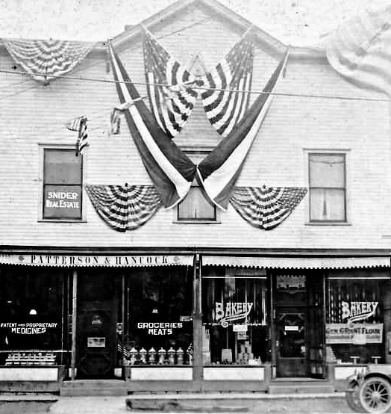
Bethel Lodge No. 61
A historical outline
May
31St
New Lodge Hall
April
23
New lodge hall constructed. Two story building on Plane Street.
New lodge hall constructed. Three story building; N. Union & Bone Street.
Bethel Lodge moved to its current building (Dillman Hall).
1821
1830
1853
1853
1900
1910
2021
December 12th
Jesse R. Grant SW
J.O.U.A.M – D.ofA. Hall
May
1st
Charter received from the Grand Lodge of Ohio.
Bro. Grant sets as SW. Later that year selling his tannery and moving to Illinois.
Lodge meets above the Ben Franklin store in another fraternal hall.
200th Year Reconsecration ceremony.

Slide 2
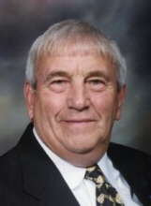
Acknowledgement
Ralph A Parker, jr. – Past Master 1971
Brother Parker served as the Master of Bethel Lodge No. 61 during our Sesquicentennial Celebration (150 years) in 1971.
Thanks to his efforts and those of his predecessors, we possess a solid understanding of the significant dates and brethren that are part of our lodge's history.
Ralph Parker was a WW2 Veteran and proud past master of our lodge. He passed at age 91 on August 20, 2014.

Slide 3
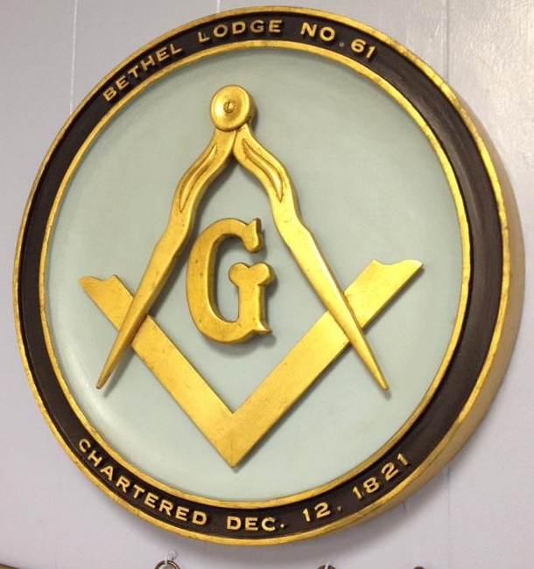
A Historical Sketch
Bethel Lodge No. 61 – Free & Accepted Masons of Ohio
Bethel Lodge No. 61, F. &. A. M. had its beginnings on March 8, 1821. Bro. William Walters of Clermont Social Lodge No. 29, Williamsburg, Ohio, installed the following officers on a special dispensation from the Grand Lodge of Ohio:
George J. Trautwine, W.M.
Jonathon D. Morris, S.W.
John A. Smith, J.W.
Houton Clark, Treas.
John Rogers, Sec’y
William Knowles, S.D.
Isaac South, J.D.
John Molyneaux, Steward
Benjamin Tingley, Tyler

Slide 4
A Historical Sketch
Bethel Lodge No. 61 – Free & Accepted Masons of Ohio
The first regular meeting was held on Wednesday, March 14, 1821. Among those present was Jesse R. Grant, father of President Ulysees S. Grant and the first mayor of Bethel in 1851. The first secretary of the lodge, Dr. John G. Rogers, was the physician in attendance at the birth of President Grant in Point Pleasant.
Ten of the Charter Members of Bethel Lodge were from the Clermont Social Lodge No. 29, Williamsburg. At that time the lodge in Williamsburg was a considerable trip for members to the south because of the roads and weather conditions, so these members found it expedient to establish the new lodge at Bethel. Their charter was received from the Grand Lodge and is dated December 12, 1821.
The officers were consecrated and installed, again by Bro. Waters, on January 16, 1822. At that time all the original officers were installed with these changes:
Jonathan Vandike, Sec’y
James Duncanson, S.D.
Abraham Conrey, Steward & Tyler

Slide 5
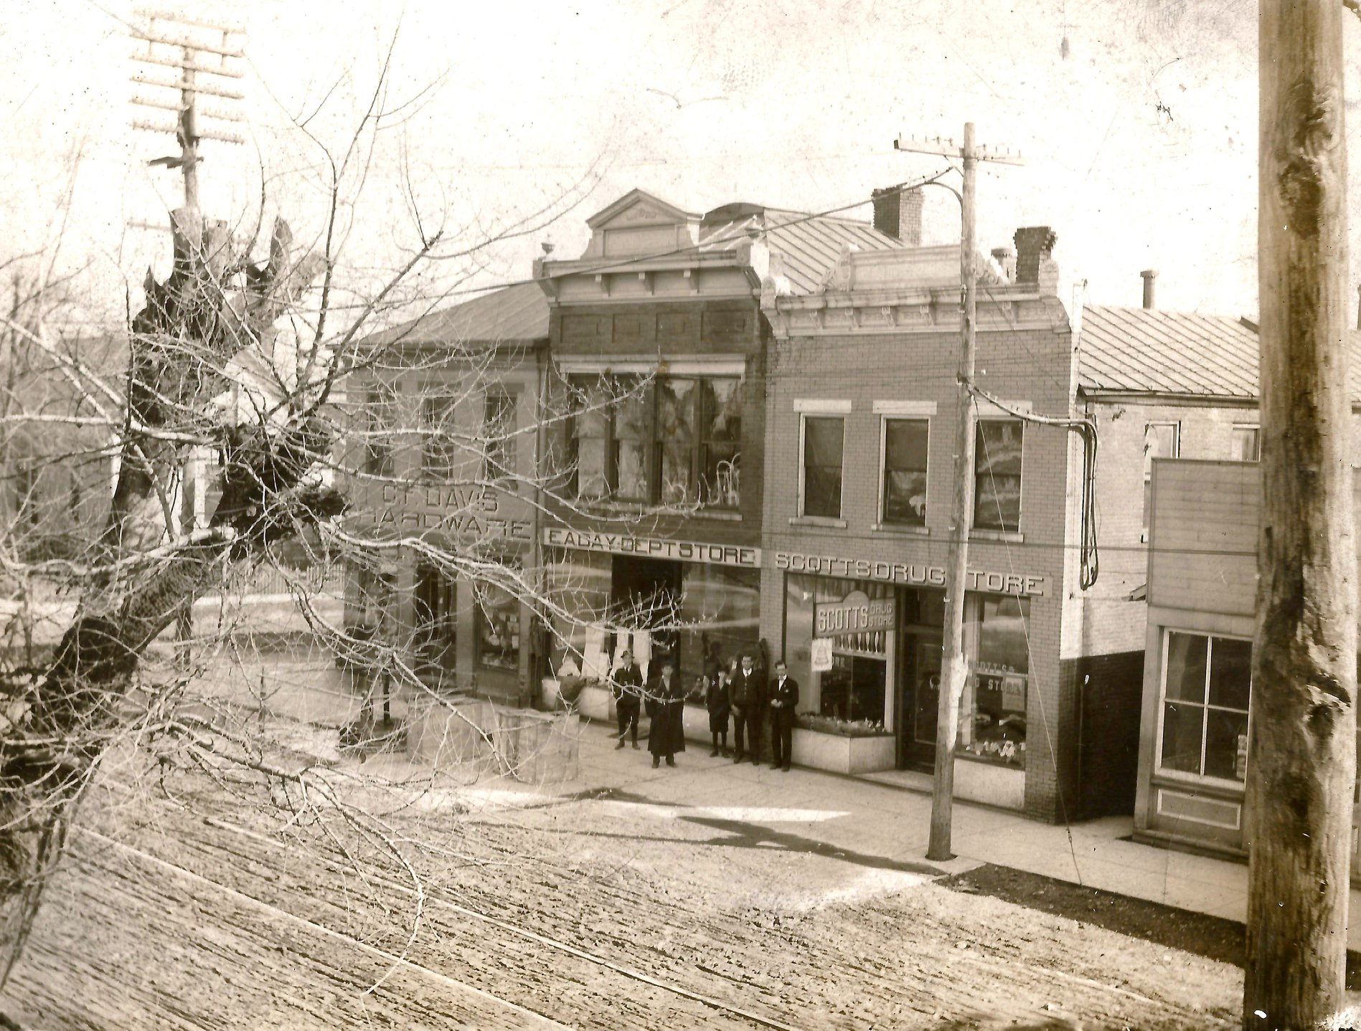
A Historical Sketch
Bethel Lodge No. 61 – Free & Accepted Masons of Ohio
In the early months, Bethel Lodge met at the various homes of members. In 1822 they rented a lodge room on North Main Street from Thomas Morris (later to be U.S. Senator) for $24.00 per year. Later, they rented a room from Bro. Isaac South who also furnished firewood, all for $18.00 per year.
In 1828 an arrangement was made with the school directors of district No. 1, whereby the Masons were allowed to add an additional story to the schoolhouse, which was then being built, for a lodge-room. On May 31, 1830, they moved into their new lodge hall, this building was on the northwest corner of Plane and Charity Streets in a building that no longer stands.
Lodge dues in those early years were 12 ½ cents per month, payable at each meeting.

Slide 6
A Historical Sketch
Bethel Lodge No. 61 – Free & Accepted Masons of Ohio
Jesse R. Grant became the Senior Warden of Bethel Lodge in 1853. It was during that year he sold his tannery on S. Charity Street and he and his wife moved to Galena, Ill. Ulysses was at West Point at this time. Bro. Jesse Grant presented a crystal lamp chandelier to the lodge which is still a prized possession of our lodge and now hangs in the dining room.
Also, in 1853 a new building was erected by the lodge at the corner of N. Union and Bone. This was a three-story structure and again, the lodge used only the top floor, the other two being used by the school.

Slide 7
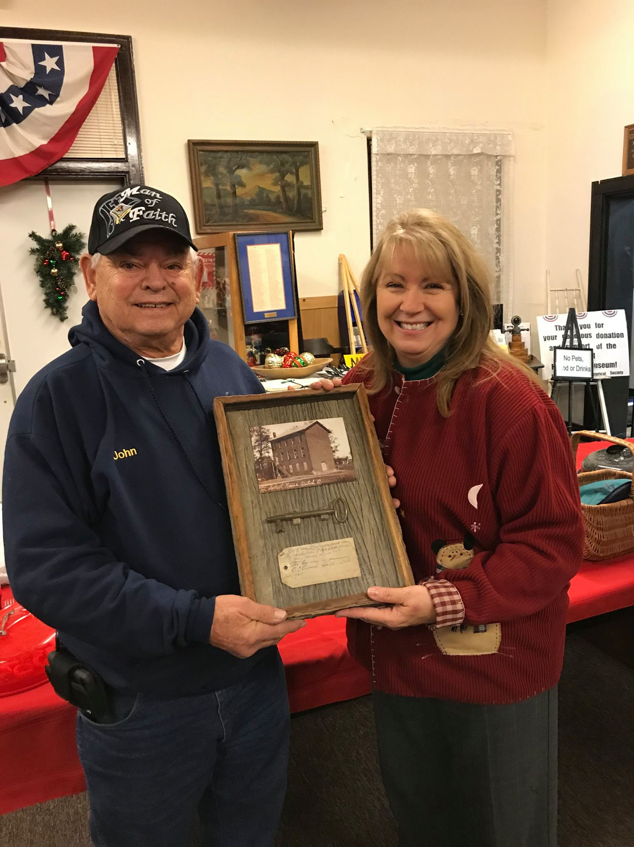
A Historical Sketch
Bethel Lodge No. 61 – Free & Accepted Masons of Ohio
This building stood in the vicinity of somewhere between where KeyBank and the community center now stand today. An old skeleton key for the entrance of the lodge was in possession of D. Elwood South (a member of the lodge) until 1930, when it was placed in the safe that still sets next to the secretary's desk.
In 2017, Bro. John Mattes presented the framed key to Judi Adams, the President of the Bethel Historical Society & Museum, where it is proudly displayed today as part of our town's history across the street at the Grant Memorial building.

Slide 8
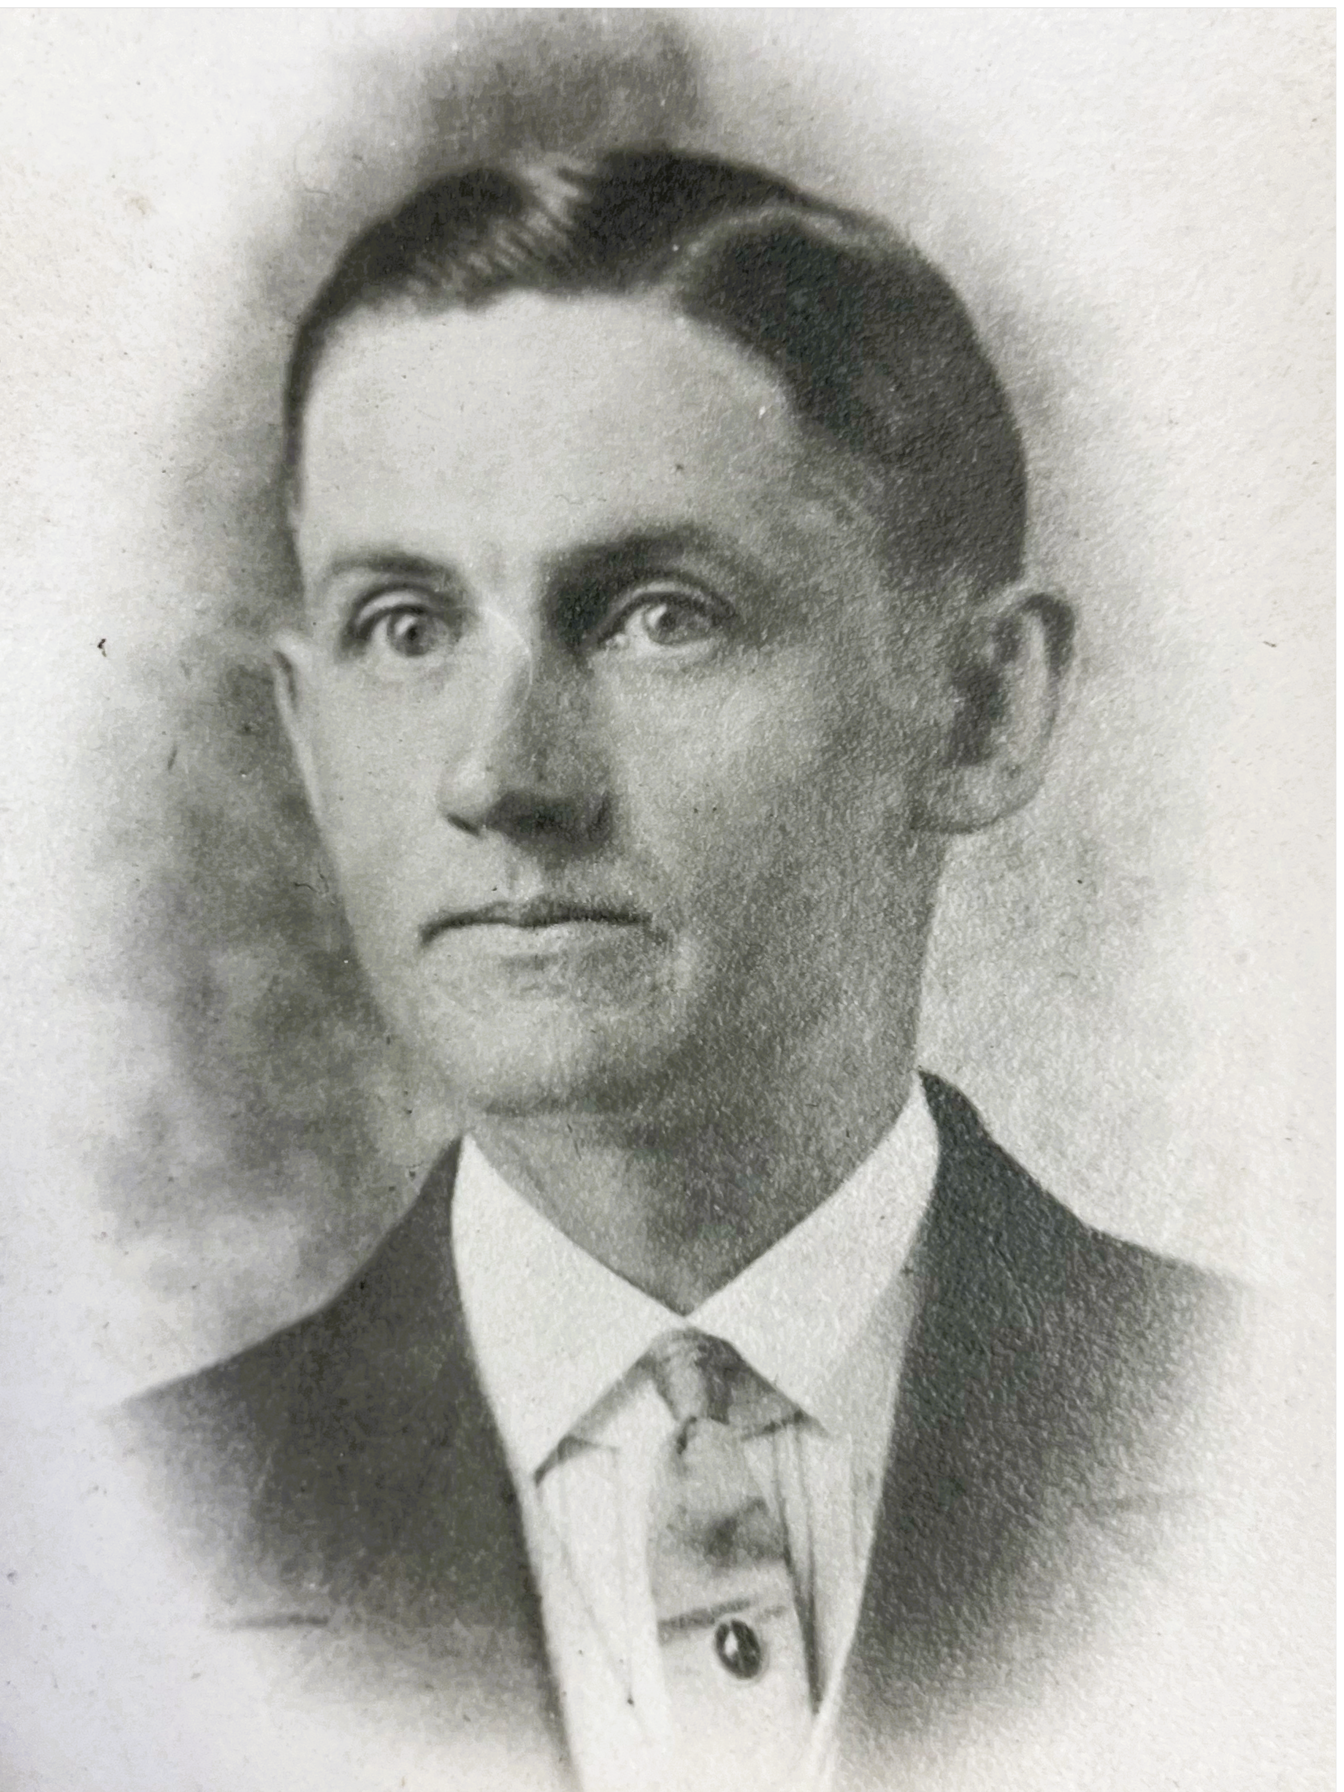
A Historical Sketch
Bethel Lodge No. 61 – Free & Accepted Masons of Ohio
Near the turn of the century the lodge met in a building which stood where the present hall now is. In the early 1900’s the lodge met in the J.O.U.A.M. - D. of A. Hall (above present Ben Franklin Store). On October 27, 1909, the lodge voted to vacate this hall and received a dispensation to meet in the I.O.O.F. Hall (next to the present building). The first meeting was held there on November 24, 1909. At that meeting a motion was made and carried to bid $5,000 for Dillman Hall (the present building).
On April 23, 1910, the Grand Master of Ohio, G.W. McKibben, and other Grand Officers opened lodge in the I.O.O.F. Hall. The lodge proceeded to the new hall next door which was then dedicated by the Grand Master. A new altar Bible was presented to the lodge by Bro. G.B. Johnston and another by Bro. O.B. Scott. The old Bible was presented to W. Bro. John Tribble by the lodge. Labor was resumed and the first man to be raised to the sublime degree of Master Mason in the new hall was O. Lee Page, former president of the First National Bank and a leading citizen of Bethel for many years. Bro. Page became Master of the lodge in 1913.

Slide 9
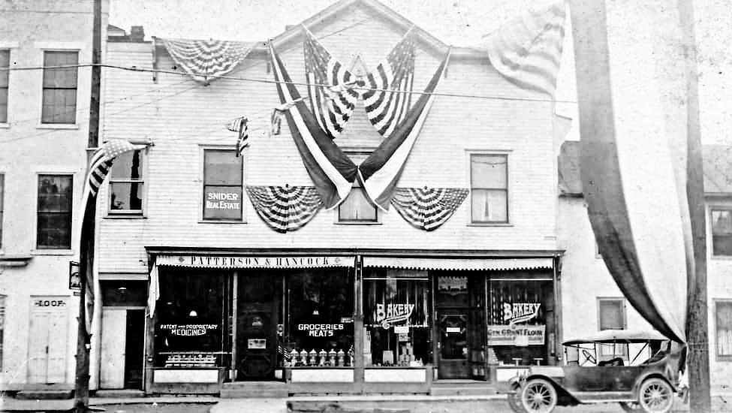
A Historical Sketch
Bethel Lodge No. 61 – Free & Accepted Masons of Ohio

Slide 10
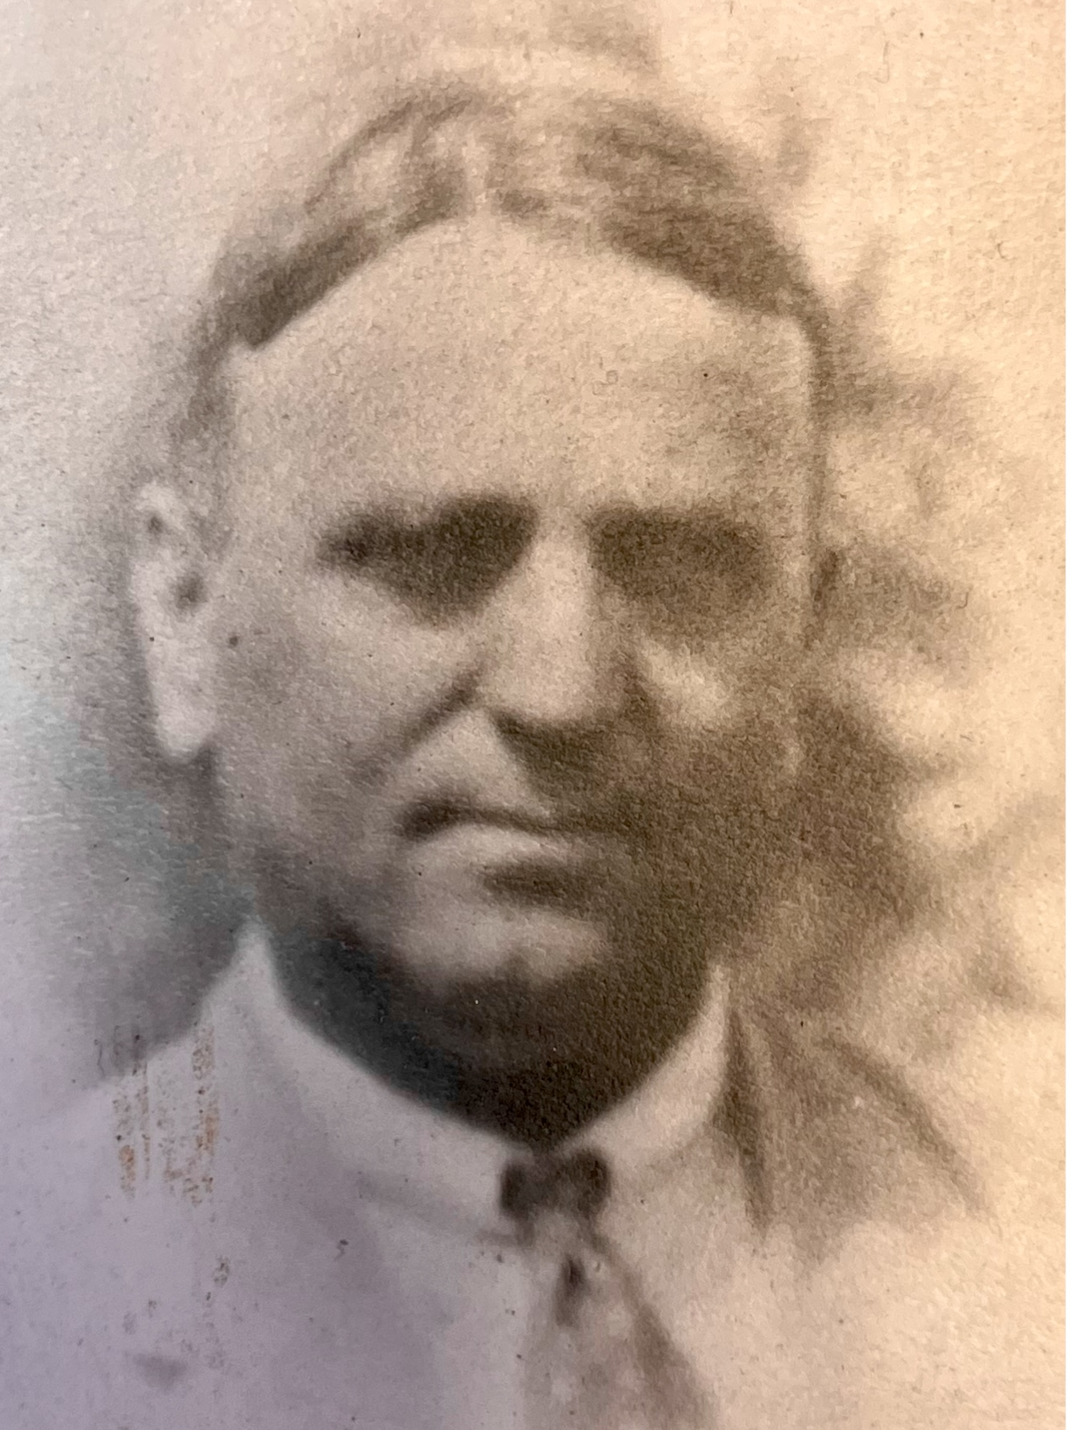
A Historical Sketch
Bethel Lodge No. 61 – Free & Accepted Masons of Ohio
This was the last move of the lodge, and this has been our home since 1910.
On March 17, 1921, a centennial program of Bethel Lodge was held at 1 p.m. in the K. of P. Hall with Grand Master of Ohio, J.R. Flotron as speaker. A banquet was served to 250 people in the I.O.O.F. Hall from 5 to 7 p.m. After which lodge opened in the Masonic Hall with 71 Master Masons present. E.J. Manning was W.M. that year.
The 125th Anniversary of the lodge was observed on December 11, 1946. The lodge opened at 4:30 p.m. with Grand Master William Carlton present. A dinner was held at the school at 6:30 followed by a very entertaining program of local talent.

Slide 11
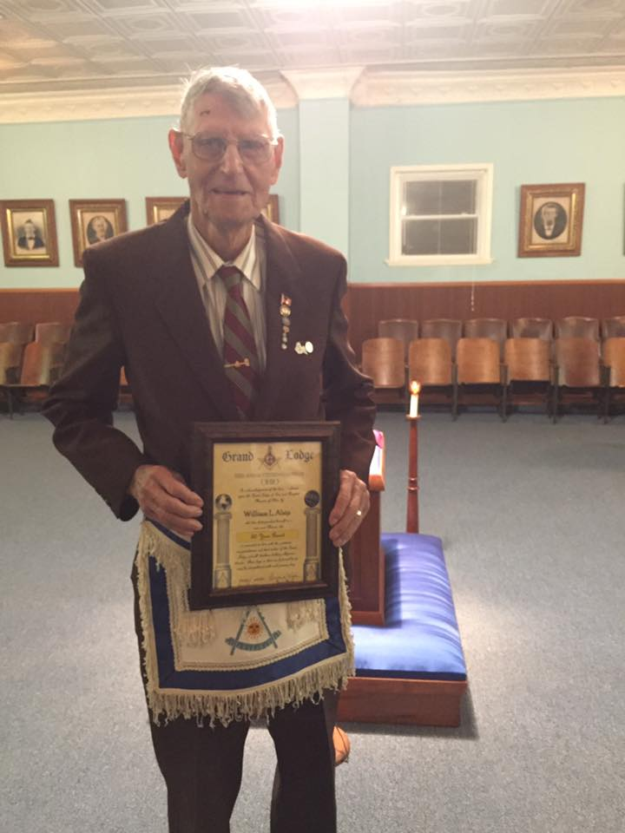
A Historical Sketch
Bethel Lodge No. 61 – Free & Accepted Masons of Ohio
In 1971 the lodge celebrated it’s 150th. anniversary and Bro. Parker whom we acknowledged at the beginning of this presentation was the master at that time.
In June of 1973, a local arsonist attempted to burn the lodge down along with several other fires started in town. Legend has it that Bro. William Alsip (who was the master that year) bravely entered the lodge and saved the chandelier and charter. Bro. Alsip passed in 2020 at the age of 96 and was a true wealth of knowledge.

Slide 12
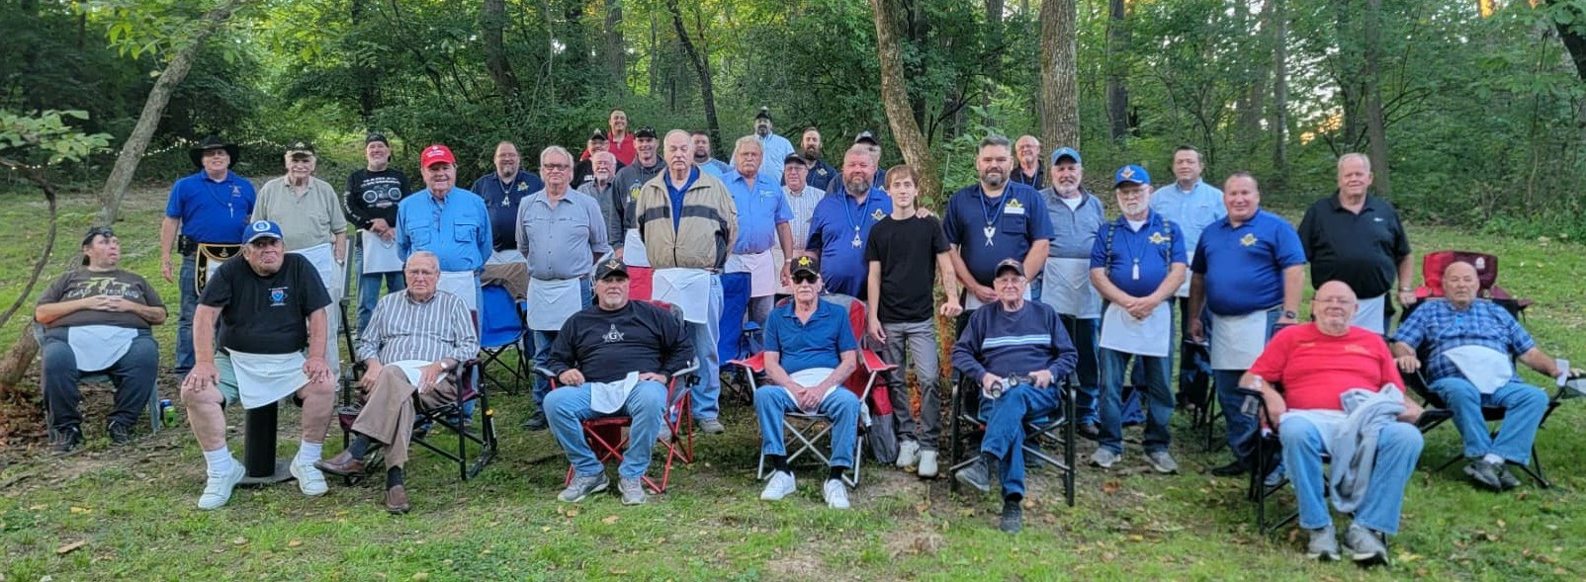
A Historical Sketch
Bethel Lodge No. 61 – Free & Accepted Masons of Ohio
In 2016 Bethel Lodge began having an annual outdoor evening degree at Honorary Bro. Wendell Kelch’s property in Bethel. It’s a tradition that includes home churned ice cream and a great night of degree work and fellowship.

Slide 13
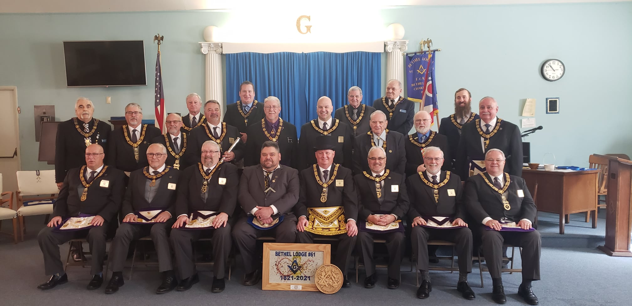
A Historical Sketch
Bethel Lodge No. 61 – Free & Accepted Masons of Ohio
In 2021 Bethel Lodge celebrated its bicentennial with the Grand Master of Ohio, Rich Dickersheid, and other Grand Lodge Officers joining us for our 200-year Reconsecration ceremony. Several members of Bethel Lodge took part in this very special ceremony.

Slide 14
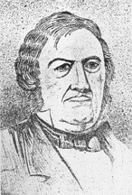
Notable Members & Fellows
Our connections to American history
While U.S. Senator Thomas Morris (January 3, 1776 – December 7, 1844) has not been identified as a Freemason in any of my research, he is notably mentioned in the minutes from our early years. His eldest son Jonathan D. Morris (Thirtieth Congress in the U.S. House), was our first Senior Warden.
Thomas’ residence on North Main Street served as the lodge room during its formative years. The lodge paid an annual fee of $24.00 (for which we still have receipts).
It is reasonable to assume that he was likely a member of our lodge. Given his active role in government from 1806 until his death, it’s possible he never held an office in the lodge, which complicates verification.

Slide 15
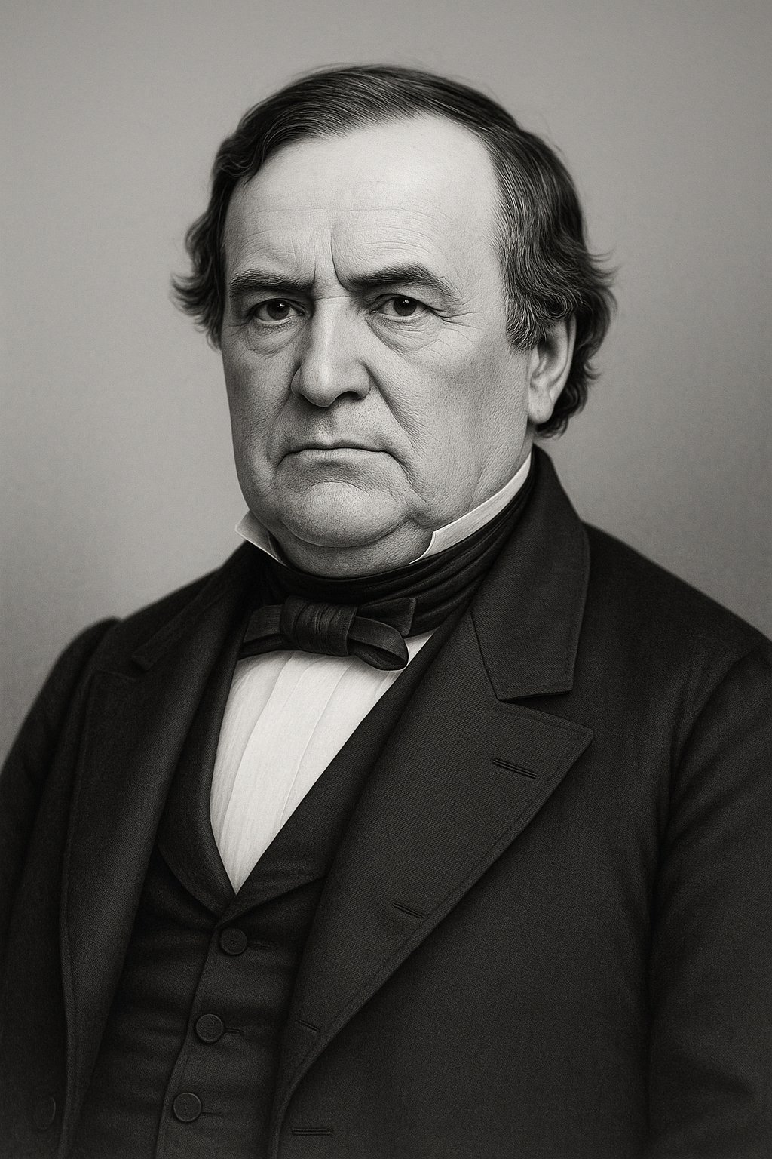
Senator Thomas Morris
A man of importance IN shaping U.S. history
Senator Morris is described by many as the first abolitionist U.S. Senator. His anti-slavery stances in the Senate in 1836 were echoed by future President Abraham Lincoln in 1860 during his launch to secure the Republican nomination.
At the time, the 7th Vice President - John C. Calhoun (then a Senator from SC), claimed that the Constitution protected the right to slave property. Morris argued that “the word slave or slavery is not to be found in the Constitution… The slave is treated as a person, not a thing.” As a result, “I deny that the right… of the master to his slave property, is founded or arises from the Constitution”
No photographs were ever taken of Senator Morris. The image on the left is an AI rendering created from the only known drawing of him.

Slide 16
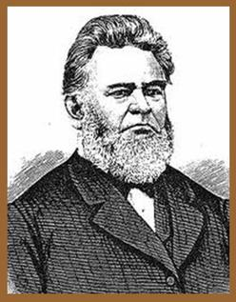
Dr. John G. Rogers
Clermont County Anti-Slavery Society
Dr. John George Rogers was the charter Secretary of Bethel Lodge No. 61. Dr. Rogers was the first president of the Clermont County Anti-Slavery Society.
Dr. Rogers practiced medicine for over 60 years and is most noted for the delivery of President Ulysses S. Grant on April 27, 1822, in nearby Pt. Pleasant.
He was a member of a group known as The Chieftains of Liberty, a vigilance committee set up to protect Birney’s press from destruction by pro-slavery mobs from Kentucky and Cincinnati. Rogers died in 1882 thus he was able to see the child that he delivered win the war that liberated 4 million enslaved African Americans, the goal that Rogers dedicated most of his life to accomplish.

Slide 17
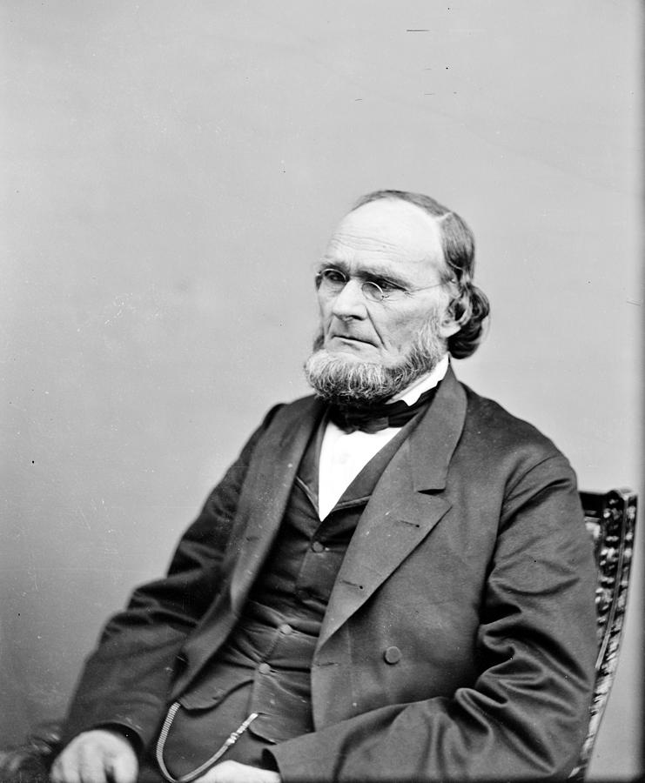
Jesse Root Grant
Father of a president
Jesse Root Grant (the father of President Grant) was a charter member of Bethel Lodge No. 61. Jesse settled in Point Pleasant in 1820, moved to Georgetown in 1823 and back to Bethel in 1841. Purchasing the home of Senator Morris. Brother Grant was the first mayor of Bethel in 1851.
Jesse Grant became Senior Warden of Bethel Lodge in 1853. It was during that year he sold his tannery on S. Charity Street and he and his wife moved to Galena, Ill. Ulysses was at West Point at this time. Bro. Grant presented a crystal lamp chandelier to the lodge which is still a prized possession of our lodge and now hangs in the dining room.

Slide 18
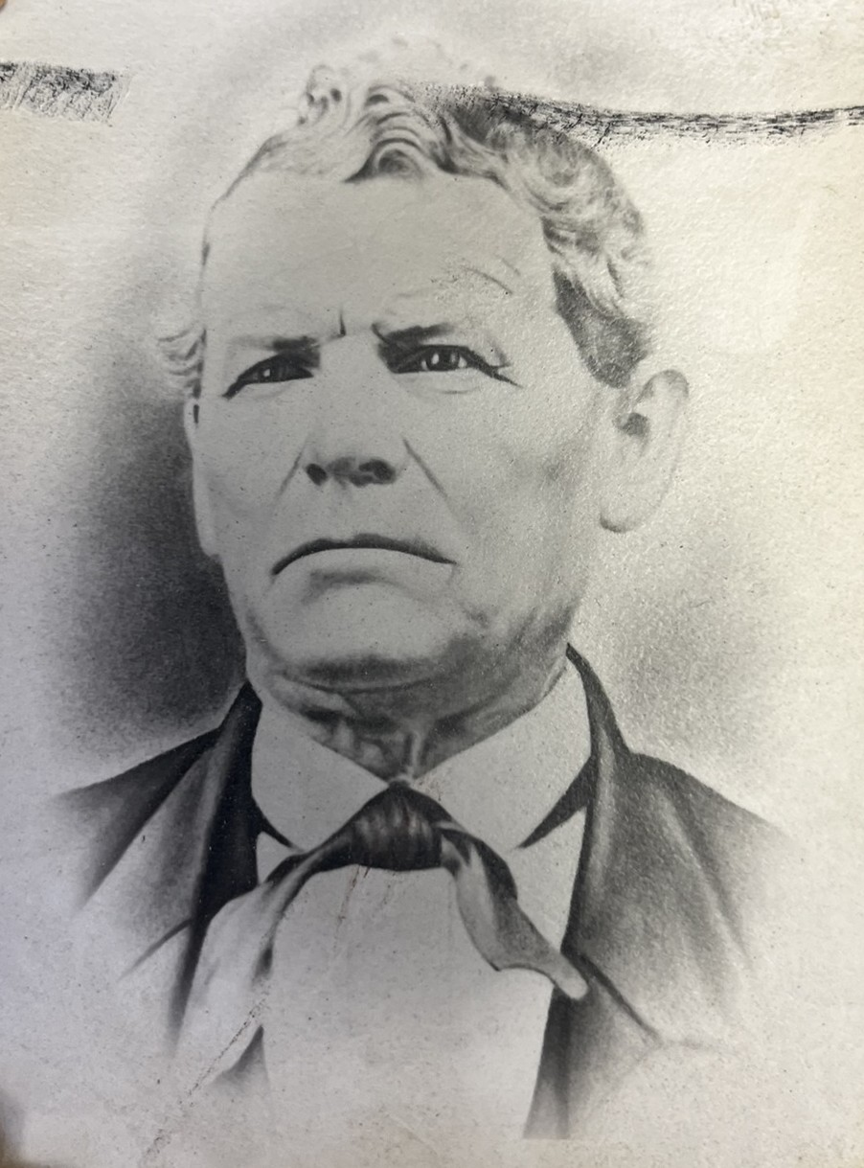
Joseph A. Perrine
Local proprietor - Perrine House
Joseph A. Perrine was the 6th master of the lodge and the first that we have a photograph of.
He became a Master Mason on December 14, 1831, and married Laura W. Trautwine (the daughter of Bethel Lodge No. 61’s first Worshipful Master – George J. Trautwine) the next day on December 15, 1831.
George Trautwine was considered Bethel’s first merchant, he was one term county commissioner, and many years a magistrate in our town. When George passed, Joseph continued the business as Perrine House which was a well-known public house in the 1880’s.
Joseph died on January 9, 1886 (aged 76). At the time of his death, he was again master of the lodge, a position he held 10 times over the course of 50 years.

Slide 19
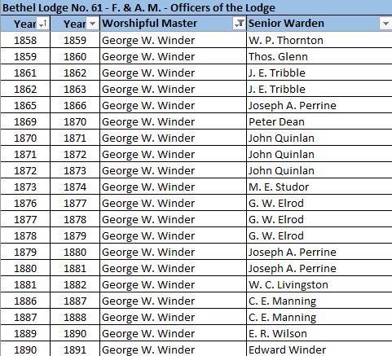
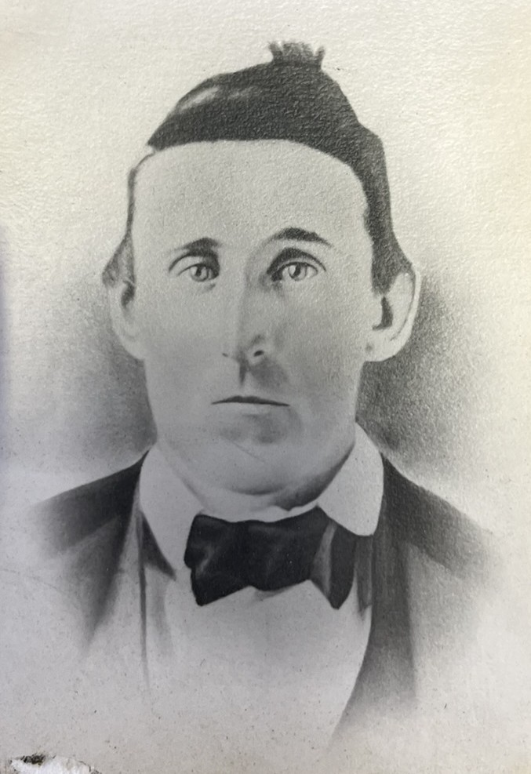
George W. Winder
The Past master champion
George W. Winder holds the unbreakable title of being the past master champion at Bethel Lodge No. 61, a staggering 20 times in his 63 years of life. He led the lodge leading up and through the Civil War years and many years through the reconstruction.

